Slide 1
Business Insights for Sterling
A Data Driven Approach
Project Team:
Victor Chukwude, Theodora Obasuyi, Samia Negash and Ezekiel Ebuetse

Slide 2
Introduction
Project Objective
To help Sterling better understand :
Customers' needs,
Preferences,
Customer’s behaviour.
Identify patterns or trends.
Make more informed decisions and
Boost effectiveness.

Slide 3
Data Overview
Source of Data
12 months sales record
Data Dimension
Rows – 283,083
Column - 19
Diagram of Data pipeline
Data Understanding
Data Preparation
Data Analysis
Insight Extraction
Forecasting

Slide 4
Data Handling and Pre-Processing
Data Cleaning, Handling of Duplicates and Inconsistencies
Missing Values:
5 Missing Values in Order ID
Duplicates:
None Found – Conc. All ID fields
Inconsistencies
Payment method. No input validation,
Recategorize into 3 headers

Slide 5
Data Handling and Pre-Processing
Feature Engineering:
Created Customer Segmentation Table
customer since | duration of patronage | frequency of order | Days since last order | Recency Score | Frequency Score | Tenure Score | Loyalty Score | Customer Segment
11/02/2008 | 14.48596851 | 2 | 54 | 4 | 1 | 1 | 6 | New Customer
23/06/2005 | 17.12525667 | 2 | 53 | 4 | 1 | 1 | 6 | New Customer
15/09/2013 | 8.895277207 | 26 | 53 | 4 | 4 | 1 | 9 | Occasional Shopper

Slide 6
Data Insights
Seasonal Trend by Orders

Slide 7
Data Insights
Regional Trend
Customers Population By Region
Sales By Region

Slide 8
Data Insights
Customer Segment by Loyalty Level

Slide 9
Data Insights
Customer Preference by Payment Method

Slide 10
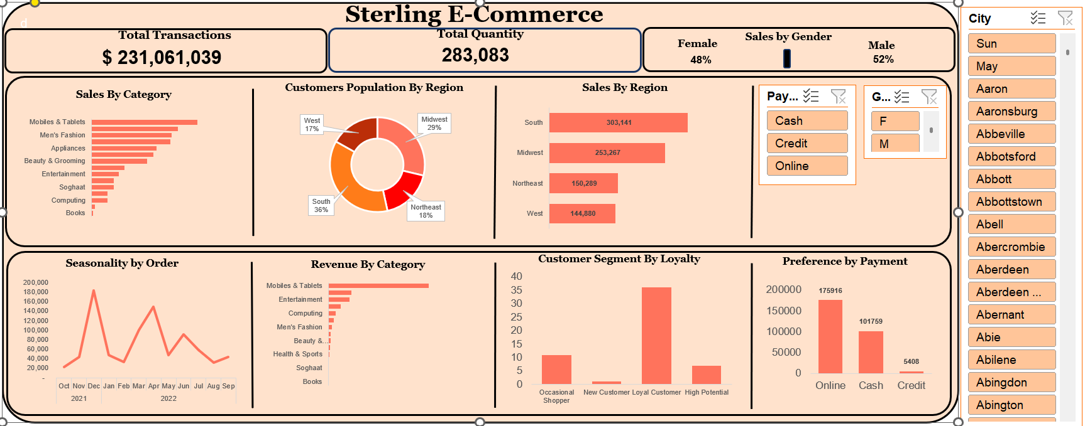
Business Insights
Dashboard

Slide 11
Business Insights
Recommendations
Institute a Customer Loyalty Scheme to to convert High Potential Customers to Loyal Customer
Reward Loyal Customers with Loyalty Discount or Company Shares
Targeted Promotional adverts for Occasional and Churned Customers
Partner with Logistics firms during high sales period to reduce logistics cost
Resources management by staff redistribution during peak sales
Target customers with preferred payment method

Slide 12
Thank you

